Slide 1
3D MED BN Footprint and IT automation requirements
(as of Jan 2026; Camps FOSTER, KINSER)
 | # W/S | # NIPR Phones | # NIPR Printers | # NIPR VTC | # SIPR Phones | # SIPR Printers | # SIPR SVTC | Other
FOS-215 (BN HQS) | 78 | 58 | 6 | 1 | 2 | 1 | 1 | 1x SIPR Shredder
FOS-5717 (Co HQS) | 68 | 38 | 4
FOS-5628 (BN Supply) | 10 | 4 | 1
KIN-300 (MSTC, BN Supply) | 22 | 5 | 0
TOTALS: | 178 | 105 | 11 | 1 | 2 | 1 | 1 | 1x SIPR Shredder

Slide 2
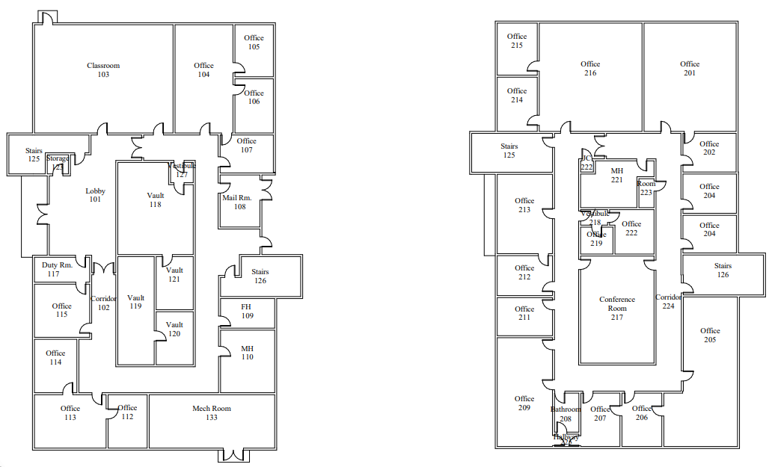
FOS-215 HQS, 3D MED BN (1st Fl)
Rm # Room Function # W/S(NIPR) #SIPR #phones # Printer
103 BN Clrm 1 2
103B S-3 Tng 8 2 1
104 S-6 10 8 1
105 S-6
106 S-6
107 Duty Rest
Chiefs Mess
Female Head
Male Head
112 SEL, GySgt 2 1
113 H&S Co Cmd 3 2 1
114 CO, XO 2 2
115 S-6 closet
117 Duty Hut 2 2
118 S-2 6 3 1
S-2
S-2 (Vault) 2 2 1 1x SIPR Printer, 1x Shredder, 1x SVTC
S-2
36 2 23 4x NIPR, 1x SIPR. 1x SVTC

Slide 3
FOS-215 HQS, 3D MED BN (2nd Fl)
Rm # Room Function # W/S(NIPR) #SIPR #phones # Printer
S-4 (vacant) Moved to KIN-300. 7x W/S, 4x phones, 1x Printer
CMO, CNO 2 2
Chaplain 2 2 door must have window
204 BN Legal 2 1
205 S-3 COPS 10 6 (3 lines) 1 TV
206 OpsO 1 1
207 XO 1 1
209 CO 1 1
210 Closet
211 ADJ 2 2
212 DCR 1 1
213 CMC 1 1 1
214 CCC 2 2 1
215 S-1 15 15 (current: 8) 1 1x shredder
216 S-1
217 Conf Rm 1 (VTC Suite)
Vestibule
Mail Room Ofc 1
Mail Stg
Male Head
Janitor Closet
Admin Stg
42 25 (35 is rqmt), 2x NIPR Printer, 1x VTC

Slide 4
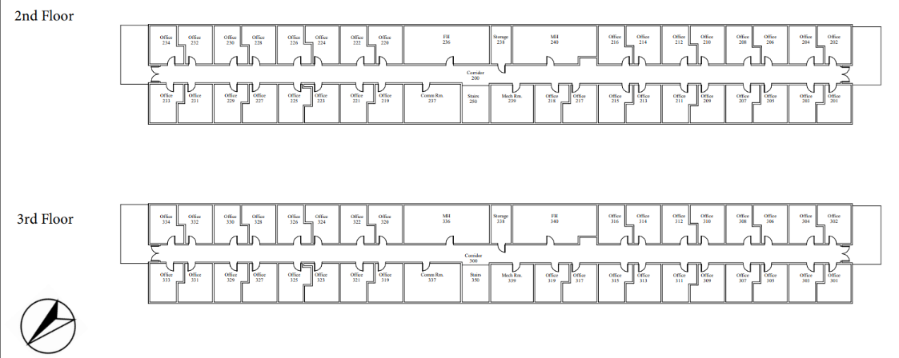
FOS-5717 Elements of H&S Co, 3D MED BN, Co HQS (2nd Fl)
NOT ASSIGNED to 3d MED BN
3d MED BN occupies
half of 2nd Floor
Rm # Room Function # W/S(NIPR) #phones # Printer
201 Safety Sect OIC 1 1
PMU OIC 1 1
PMU, Safety 2 1
204 PMU, Safety 1 1
205 PMU, Safety 2 1
PMU, Safety 2 1
PMU, Safety 2 1
PMU, Safety 1 1
PMU, Safety 1 1
PMU, Safety 2 1
211 VACANT (had mold issues; fixed)
212 PMU, Safety 1 1
213 CSP (Cbt Stress) 1 1
214 CSP 1 1
215 2 0
216 Clinic Ops, BN Surgeon 2 1
218 PRINTER 1
240 Male head
239 Mech Room
Storage/Supply (PMU, Safety)
21 14 1

Slide 5
FOS-5717 A Co, 3D MED BN, Co HQS (3rd Fl)
3d MED BN occupies
all of 3rd Floor
318
Rm # Room Function # W/S(NIPR) #phones # Printer
CO 1 1 1
XO 1 1
SEL 1 1
LPO 2 1
305 OPS Chief 2
1st PLT CDR, CPO 2 1
OPS OIC 2 1
308 2nd PLT CDR, CPO 2 1
309 Ops 2 1
310 3rd PLT OIC, LCPO 2 1
311 Ops 2 1
312 TNG LPO, LT 2 1
313 S-4 Supply Ofc 1 1
314 Swing Space 2
315 Supply 1
316 PRINTER 2 1
317 Breakroom
318 Conf Room 1
340 Female Head
339 Mech Room
28 12 2
28 12 1
Rm # Room Function # W/S(NIPR) #phones # Printer
338 Storage
337 Mech Room
336 Comm Room
319 1st PLT 1 1
320 1st PLT 1 1
321 1st PLT 2 1
322 1st PLT 1 1
323 2nd PLT 1
324 2nd PLT 1 1
325 2nd PLT 2 1
326 2nd PLT 1 1
327 PRINTER 1
Study CLRM 1 1
3rd PLT 1 1
330 3rd PLT 1 1
331 ERC (H&S Co) 1 1
332 ERC (H&S Co) 2 1
333 ERC (H&S Co) 2 1
334 ERC (H&S Co) 1
19 13 1
47 24 3

Slide 6
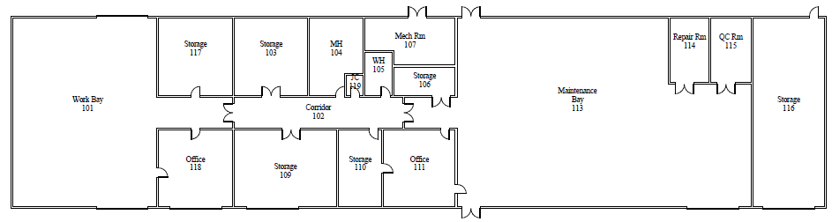
FOS-5628 3D MED BN, Supply
Location of WHSE; MNT Bay Phone
Most of unshaded areas are unoccupied
Rm # Room Function # W/S(NIPR) #phones # Printer
110 Supply OIC 3 2
111 Supply Section 5 2 1
113 WHSE; MNT Bay 2
10 4 1

Slide 7
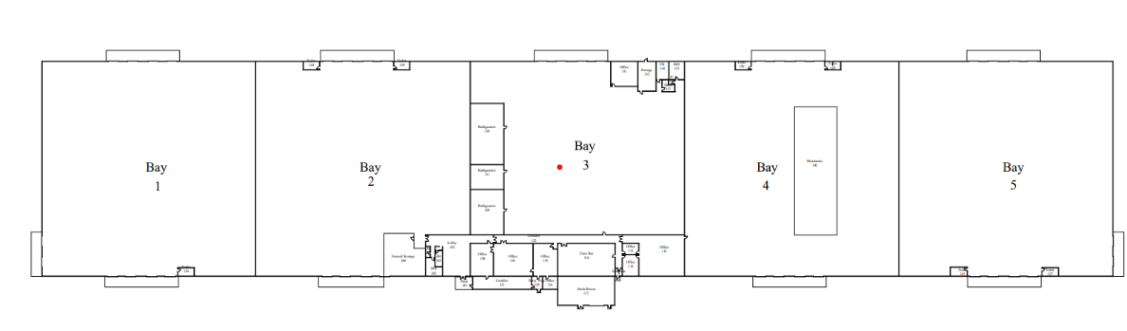
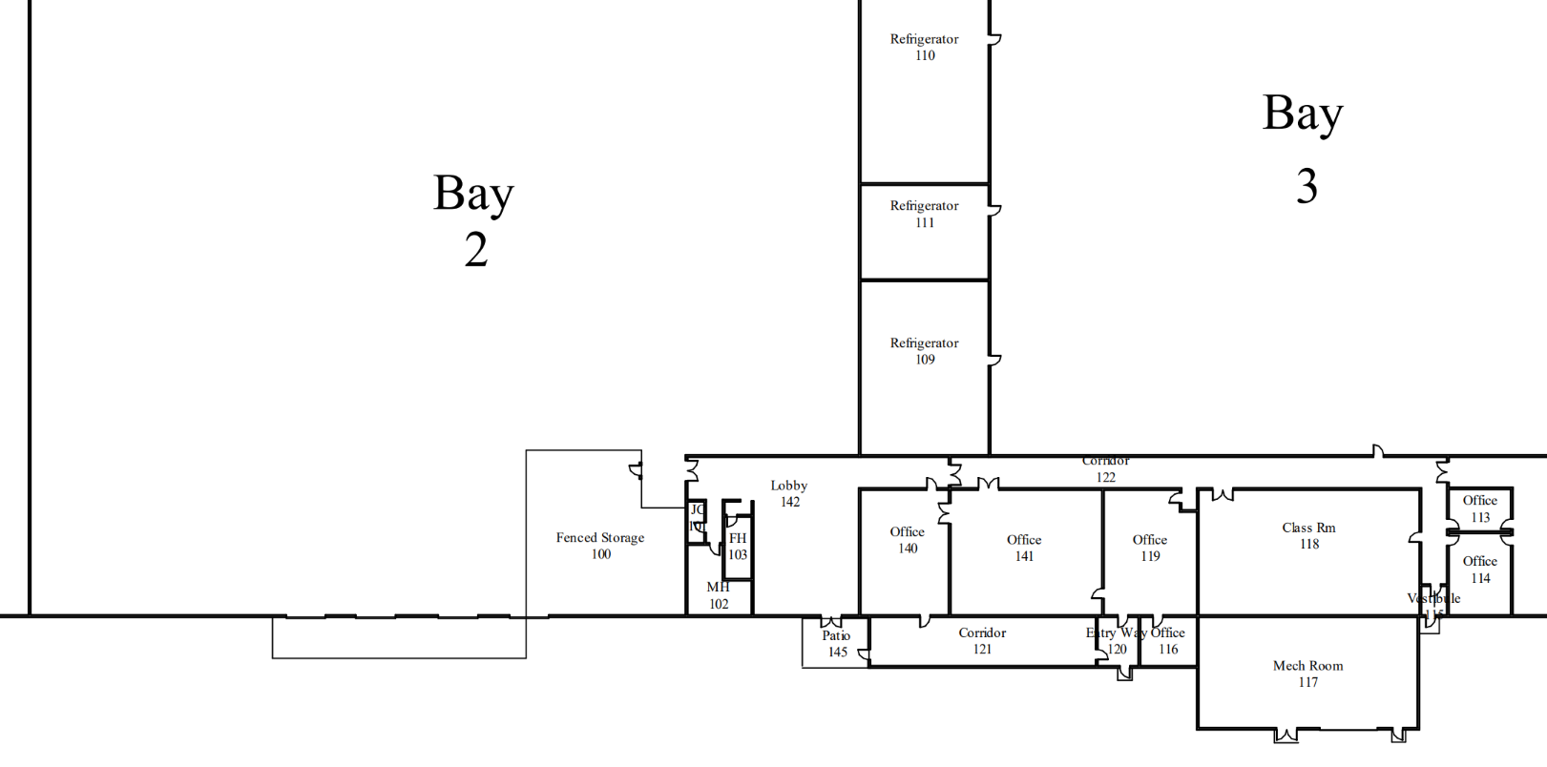
KIN-300 3D MED BN, Supply
Rations
Stored here
BAY 2, KIN-300, is shared by:
MSTC
CBRNE
Food SVC Co
119
118
Rm # Room Function # W/S(NIPR) #phones # Printer
118 MSTC Classroom 12 0
119 MSTC Staff 10 5 0
Bay 2 WHSE; MNT Bay
22 5 0

